Slide 1
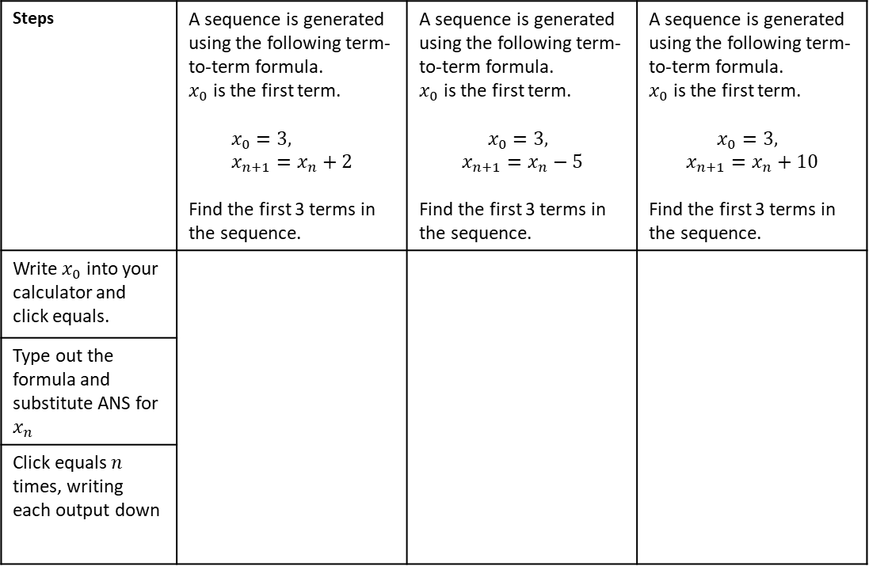
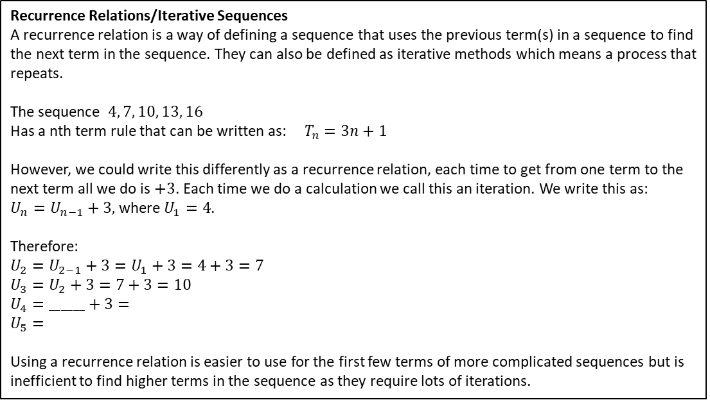
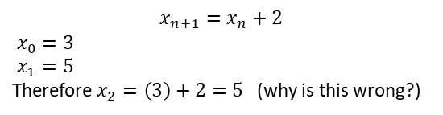
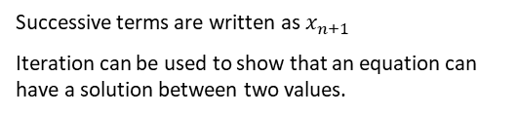
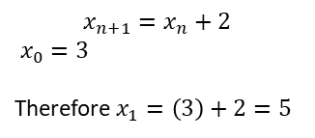
Subtopic 6a – Iteration
LEARNING OUTCOME: To use iterative process to solve equations.
Objectives:
Keywords:
Sequence
Iteration
To be able to substitute using a calculator.
To be able to use iteration to solve equations.
Recurrence Relations/Iterative Sequences
A recurrence relation is a way of defining a sequence that uses the previous term(s) in a sequence to find the next term in the sequence. They can also be defined as iterative methods which means a process that repeats.
The sequence $4, 7, 10, 13, 16$
Has a nth term rule that can be written as: $T_{n}=3n+1$
However, we could write this differently as a recurrence relation, each time to get from one term to the next term all we do is $+3$. Each time we do a calculation we call this an iteration. We write this as:
$U_{n}=U_{n−1}+3,$ where $U_{1}=4$.
Therefore:
$U_{2}=U_{2−1}+3=U_{1}+3=4+3=7$
$U_{3}=U_{2}+3=7+3=10$
$U_{4}=______+3=$
$U_{5}=$
Using a recurrence relation is easier to use for the first few terms of more complicated sequences but is
inefficient to find higher terms in the sequence as they require lots of iterations.
Definition
Characteristics
Repetition of a mathematical or computational procedure applied to the result of a previous application,
Successive terms are written as $x_{n+1}$
Iteration can be used to show that an equation can have a solution between two values.
Examples
Iteration
Non - Examples
$$x_{n+1}=x_{n}+2$$
$x_{0}=3$
Therefore $x_{1}=\left(3\right)+2=5$
$$x_{n+1}=x_{n}+2$$
$x_{0}=3$
$x_{1}=5$
Therefore $x_{2}=\left(3\right)+2=5$ (why is this wrong?)
Example 1- I do…
Example 2 - We do…
Example 3 - You do…
Steps | A sequence is generated using the following term-to-term formula. $x_{0}$ is the first term. $$x_{0}=3, x_{n+1}=x_{n}+2$$ Find the first 3 terms in the sequence. | A sequence is generated using the following term-to-term formula. $x_{0}$ is the first term. $$x_{0}=3,$$ $$x_{n+1}=x_{n}−5$$ Find the first 3 terms in the sequence. | A sequence is generated using the following term-to-term formula. $x_{0}$ is the first term. $$x_{0}=3,$$ $$x_{n+1}=x_{n}+10$$ Find the first 3 terms in the sequence.
Write $x_{0}$ into your calculator and click equals.
Type out the formula and substitute ANS for $x_{n}$
Click equals $n$ times, writing each output down
1

Slide 2





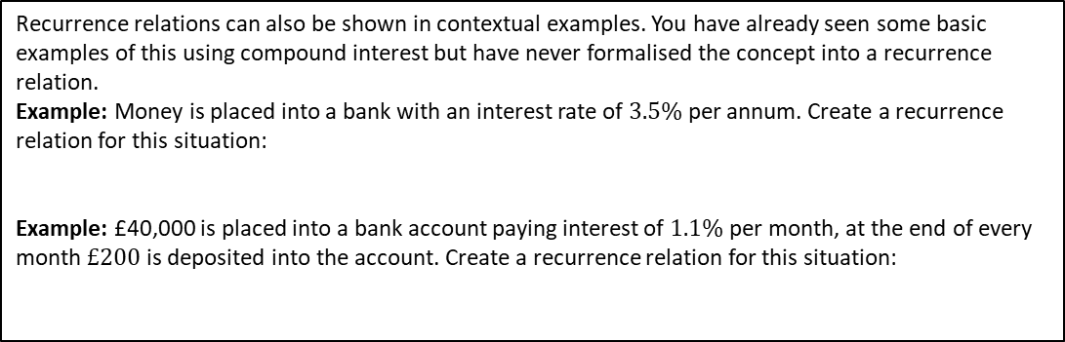

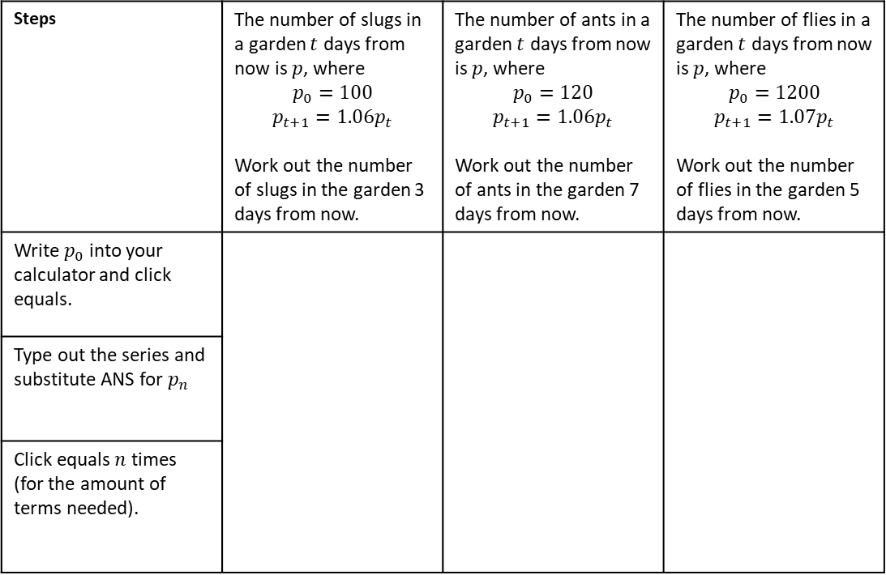








INDEPENDENT PRACTICE
1) Find the first 4 terms in each iterative sequence.
a) $x_{0}=3,$
$x_{n+1}=x_{n}−7$
b) $x_{0}=3,$
$x_{n+1}=x_{n}+9$
d) $x_{0}=3,$
$x_{n+1}={\left(x_{n}\right)}^{2} +2$
c) $x_{0}=3,$
$x_{n+1}=2x_{n}+9$
$$x_{1}=$$
$$x_{1}=$$
$$x_{1}=$$
$$x_{1}=$$
$$x_{2}=$$
$$x_{2}=$$
$$x_{2}=$$
$$x_{2}=$$
$$x_{3}=$$
$$x_{3}=$$
$$x_{3}=$$
$$x_{3}=$$
$$x_{4}=$$
$$x_{4}=$$
$$x_{4}=$$
$$x_{4}=$$
APPLICATIONS OF ITERATIVE SEQUENCES
Recurrence relations can also be shown in contextual examples. You have already seen some basic examples of this using compound interest but have never formalised the concept into a recurrence relation.
Example: Money is placed into a bank with an interest rate of $3.5\%$ per annum. Create a recurrence relation for this situation:
Example: £40,000 is placed into a bank account paying interest of $1.1\%$ per month, at the end of every month $£200$ is deposited into the account. Create a recurrence relation for this situation:
Example 4- I do…
Example 5 - We do…
Example 6 - You do…
Steps | The number of slugs in a garden $t$ days from now is $p$, where $$p_{0}=100$$ $$p_{t+1}={1.06p}_{t}$$ Work out the number of slugs in the garden 3 days from now. | The number of ants in a garden $t$ days from now is $p$, where $$p_{0}=120$$ $$p_{t+1}={1.06p}_{t}$$ Work out the number of ants in the garden 7 days from now. | The number of flies in a garden $t$ days from now is $p$, where $$p_{0}=1200$$ $$p_{t+1}={1.07p}_{t}$$ Work out the number of flies in the garden 5 days from now.
Write $p_{0}$ into your calculator and click equals.
Type out the series and substitute ANS for $p_{n}$
Click equals $n$ times (for the amount of terms needed).

Slide 3









INDEPENDENT PRACTICE
2) Use iteration to find the solution of each problem.
a) The number of slugs in a garden $t$ days from now is $p$, where
$$p_{0}=100$$
$$p_{t+1}={1.16p}_{t}$$
Work out the number of slugs in the garden 3 days from now.
b) The number of rabbits in a field $t$ days from now is $p_{t}$, where
$$p_{0}=220$$
$$p_{t+1}={1.15(p}_{t}−20)$$
Work out the number of rabbits in the field 5 days from now.
c) The number of people living in a town $t$ years from now is $p_{t}$, where
$$p_{0}=55000$$
$$p_{t+1}={1.03(p}_{t}−800)$$
Work out the number people in the town, 3 years from now.
d) The number of slugs in a garden $t$ days from now is $p$, where
$$p_{0}=200$$
$$p_{t+1}={1.07p}_{t}$$
Work out the number of slugs in the garden 6 days from now.
e) The number of rabbits in a field $t$ days from now is $p_{t}$, where
$$p_{0}=520$$
$$p_{t+1}={1.14(p}_{t}−10)$$
Work out the number of rabbits in the field 7 days from now.
f) The number of people living in a town $t$ years from now is $p_{t}$, where
$$p_{0}=40000$$
$$p_{t+1}={1.08(p}_{t}−800)$$
Work out the number people in the town 5 years from now.
g) The number of slugs in a garden $t$ days from now is $p$, where
$$p_{0}=100$$
$$p_{t+1}={1.16p}_{t}$$
Work out the number of slugs in the garden 13 days from now.
h) The number of rabbits in a field $t$ days from now is $p_{t}$, where
$$p_{0}=220$$
$$p_{t+1}={1.15(p}_{t}−20)$$
Work out the number of rabbits in the field 18 days from now.
i) The number of people living in a town $t$ years from now is $p_{t}$, where
$$p_{0}=55000$$
$$p_{t+1}={1.03(p}_{t}−800)$$
Work out the number people in the town 14 years from now.

Slide 4
Example - I do…
Example - We do…
Steps | At time t = 0 hours a tank is full of water. Water leaks from the tank. At the end of every hour there is 2% less water in the tank than at the start of the hour. The volume of water, in litres, in the tank at time t hours is V_{t} Given that V₀ = 2000 V_{t+1} = kV_{t} write down the value of k. | At the start of year n, the number of animals in a population is P_{n} At the start of the following year, the number of animals in the population is P_{n + 1} where P_{n + 1} = kP_{n} At the start of 2017 the number of animals in the population was 4000 At the start of 2019 the number of animals in the population was 3610 Find the value of the constant k.
Consider the relationship between this period’s key numbers and the next period’s
Work out any relevant multipliers (>1 if growing and <1 if depreciating)
Write as a recurrence relationship if required
INDEPENDENT PRACTICE
At the start of year n, the number of animals in a population is P_{n} At the start of the following year, the number of animals in the population is P_{n + 1} where P_{n + 1} = kP_{n} At the start of 2017 the number of animals in the population was 8000 At the start of 2020 the number of animals in the population was 4913 Find the value of the constant k. | A hot air balloon is descending. The height of the balloon n minutes after it starts to descend is h_{n} metres. The height of the balloon (n +1) minutes after it starts to descend, h_{n + 1} metres, is given by h_{n + 1} = K × h_{n} + 50 where K is a constant. The balloon starts to descend from a height of 1500 metres at 09 15 At 09 16 the height of the balloon is 1400 metres. Work out the height of the balloon at 09 20

Slide 5
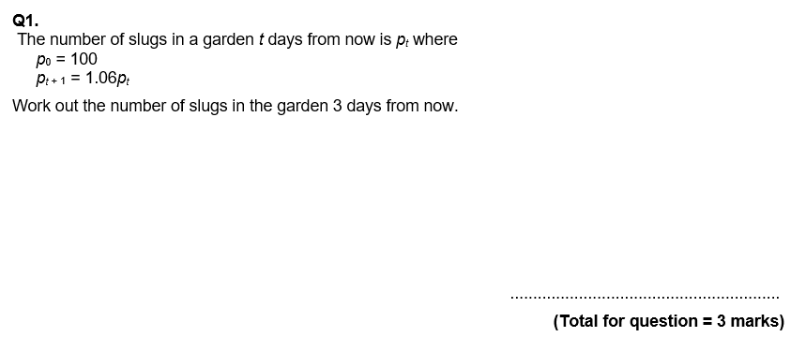
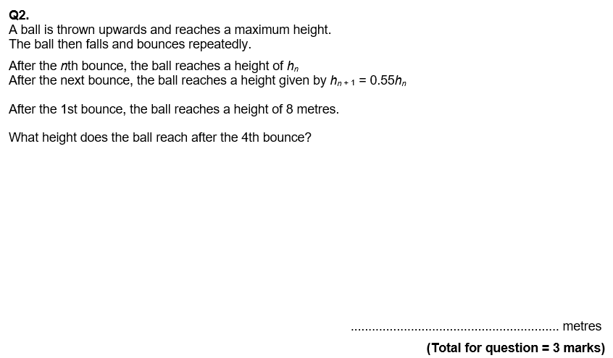
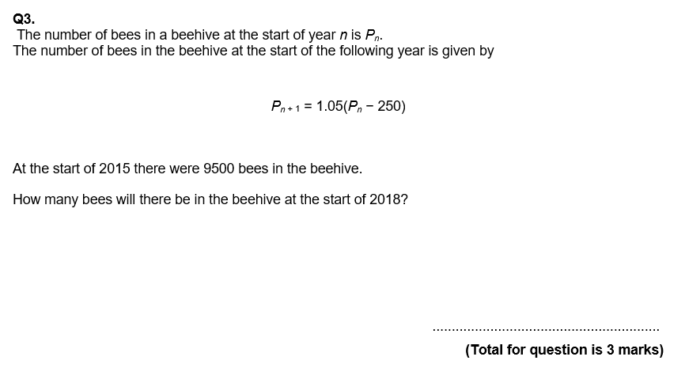
GCSE QUESTIONS

Slide 6
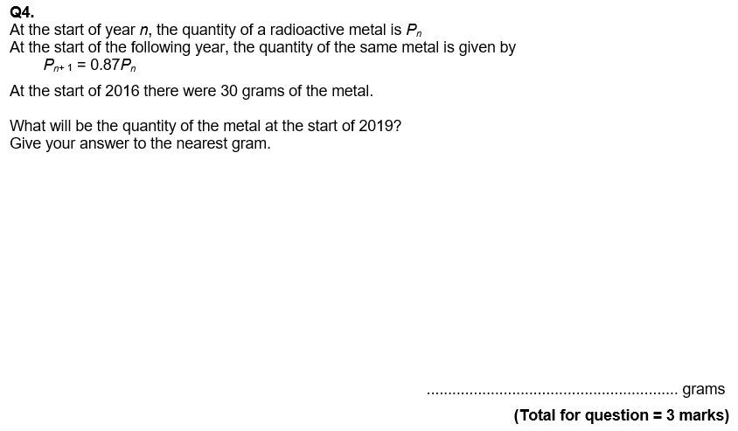
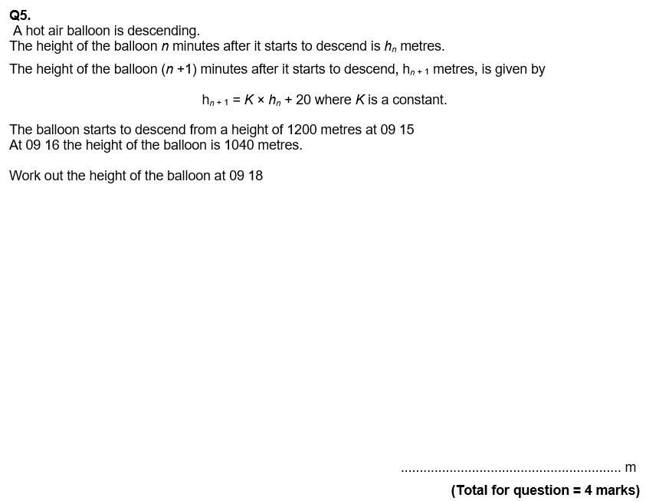

Slide 7



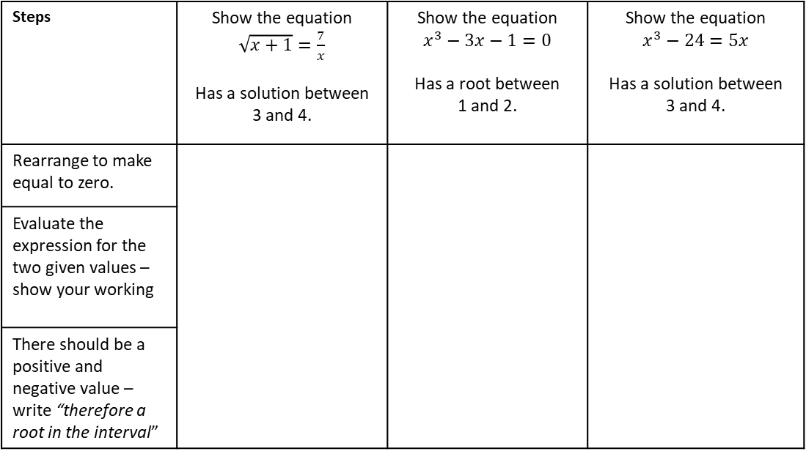



Subtopic 6b – Using Iteration to Estimate Solutions to Equations
Iteration is a way of estimating solutions to difficult equations – if you study A-level maths you will learn a lot more about it. For now, you need to know that GCSE questions generally follow a predictable pattern in what you are asked to do. First, you will be asked to ‘show there is a solution’ (or ‘root’) in a given interval (i.e. between two numbers). The following examples show how to answer this:
Example 7- I do…
Example 8 - We do…
Example 9 - You do…
Steps | Show the equation $\sqrt{x+1}=\frac{7}{x}$ Has a solution between 3 and 4. | Show the equation $$x^{3}−3x−1=0$$ Has a root between 1 and 2. | Show the equation $$x^{3}−24=5x$$ Has a solution between 3 and 4.
Rearrange to make equal to zero.
Evaluate the expression for the two given values – show your working
There should be a positive and negative value – write “therefore a root in the interval”
INDEPENDENT PRACTICE
3) Use iteration to….
a) Show that $x−\sqrt{x}−1=0$ has a root between 2.6 and 2.7
b) Show that $x^{3}+4x=1$ has a root between 0 and 1
c) Show that $4x^{3}−2x−5=0$ has a root between 1 and 2
d) Show that $3x−x^{3}=−11$ has a root between 2 and 3
e) Show that $x^{4}−5x+1=0$ has a root between 1.5 and 2
f) Show that $x^{3}+5=2x$ has a root between -2 and -3

Slide 8
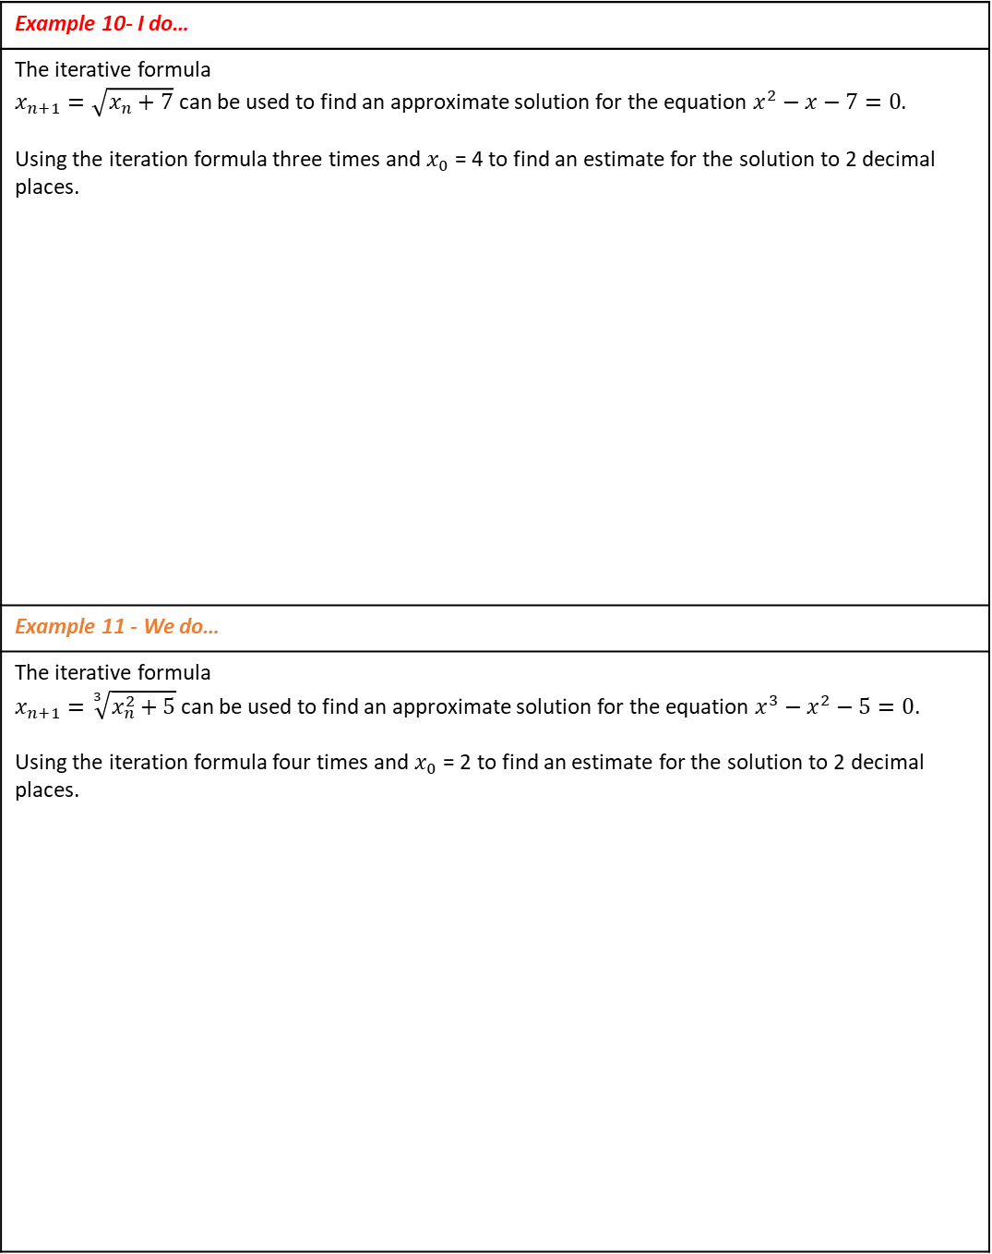
ITERATION TO SOLVE EQUATIONS
The next steps to estimating solutions are to:
Rearrange the equation to a given form and then…
Substitute values into the iteration formula (over and over again)
The second of these is slightly more straightforward so we will practice that before combining with the first part….
Example 10- I do…
The iterative formula $x_{n+1}=\sqrt{x_{n}+7}$ can be used to find an approximate solution for the equation $x^{2}−x−7=0$. Using the iteration formula three times and $x_{0}$ = 4 to find an estimate for the solution to 2 decimal places.
Example 11 - We do…
The iterative formula $x_{n+1}=\sqrt[3]{x_{n}^{2}+5}$ can be used to find an approximate solution for the equation $x^{3}−x^{2}−5=0$. Using the iteration formula four times and $x_{0}$ = 2 to find an estimate for the solution to 2 decimal places.

Slide 9
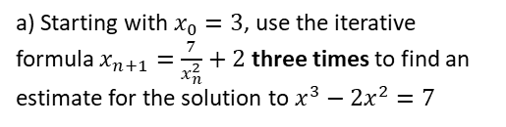
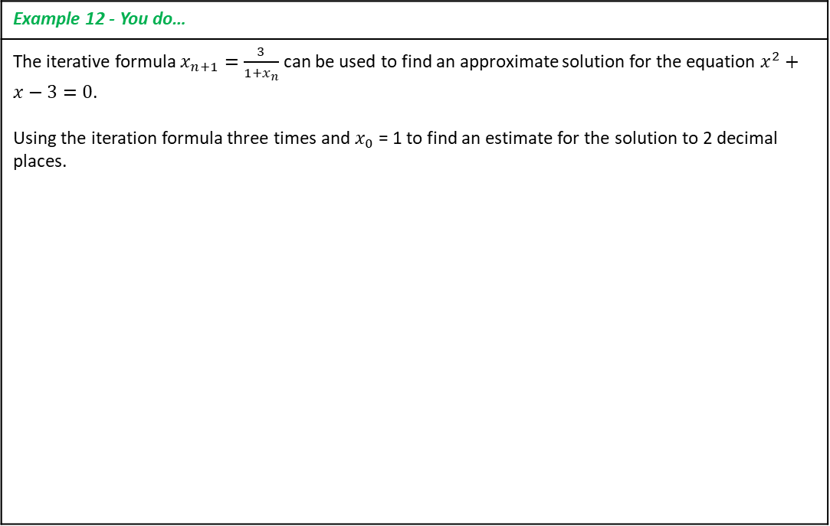
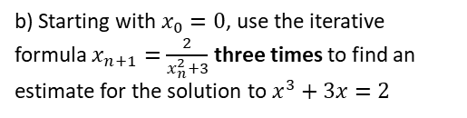
Example 12 - You do…
The iterative formula $x_{n+1}=\frac{3}{1+x_{n}}$ can be used to find an approximate solution for the equation $x^{2}+x−3=0$. Using the iteration formula three times and $x_{0}$ = 1 to find an estimate for the solution to 2 decimal places.
INDEPENDENT PRACTICE
4) Use the iterative formulae to find estimates of solutions for each equation.
a) Starting with $x_{0}=3$, use the iterative formula $x_{n+1}=\frac{7}{x_{n}^{2}}+2$ three times to find an estimate for the solution to $x^{3}−2x^{2}=7$
b) Starting with $x_{0}=0$, use the iterative formula $x_{n+1}=\frac{2}{x_{n}^{2}+3}$ three times to find an estimate for the solution to $x^{3}+3x=2$

Slide 10
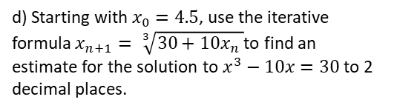
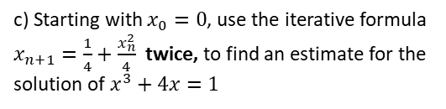
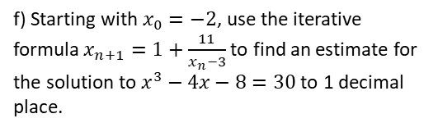
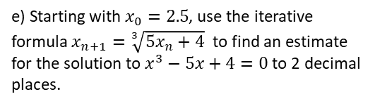
c) Starting with $x_{0}=0$, use the iterative formula $x_{n+1}=\frac{1}{4}+\frac{x_{n}^{2}}{4}$ twice, to find an estimate for the solution of $x^{3}+4x=1$
d) Starting with $x_{0}=4.5$, use the iterative formula $x_{n+1}= \sqrt[3]{30+10x_{n} }$to find an estimate for the solution to $x^{3}−10x=30$ to 2 decimal places.
e) Starting with $x_{0}=2.5$, use the iterative formula $x_{n+1}=\sqrt[3]{5x_{n}+4}$ to find an estimate for the solution to $x^{3}−5x+4=0$ to 2 decimal places.
f) Starting with $x_{0}=−2$, use the iterative formula $x_{n+1}=1+\frac{11}{x_{n}−3}$to find an estimate for the solution to $x^{3}−4x−8=30$ to 1 decimal place.

Slide 11
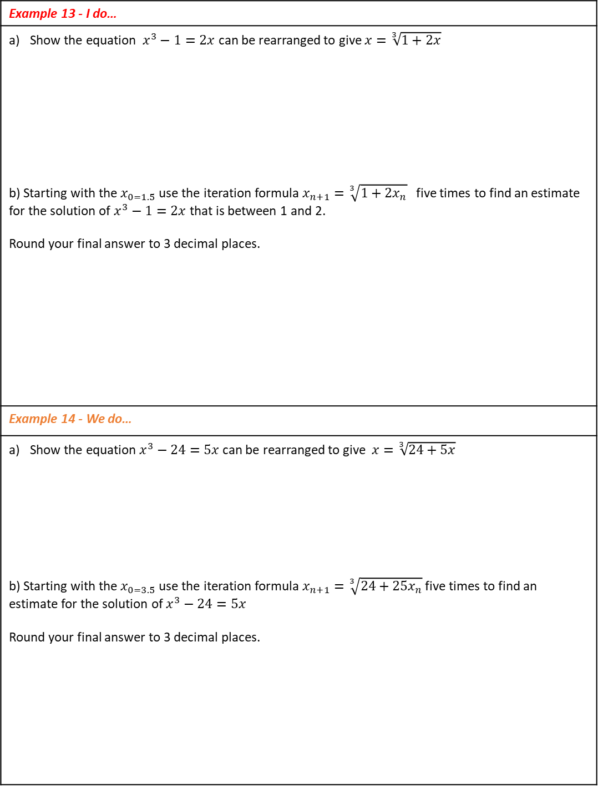
ITERATION TO SOLVE EQUATIONS
We now combine our skills of iteration with our prior knowledge of rearranging/changing the subject. This is an unusual step, but you are always given a part (a) and told ‘what to aim for’ and sometimes you need to try some trial and error before you accurately rearrange as asked. The examples below show this.
Example 13 - I do…
Show the equation $x^{3}−1=2x$ can be rearranged to give $x=\sqrt[3]{1+2x}$ b) Starting with the $x_{0=1.5}$use the iteration formula $x_{n+1}=\sqrt[3]{1+2x_{n}}$ five times to find an estimate for the solution of $x^{3}−1=2x$ that is between 1 and 2. Round your final answer to 3 decimal places.
Example 14 - We do…
Show the equation $x^{3}−24=5x$ can be rearranged to give $x=\sqrt[3]{24+5x}$ b) Starting with the $x_{0=3.5}$use the iteration formula $x_{n+1}=\sqrt[3]{24+25x_{n}}$ five times to find an estimate for the solution of $x^{3}−24=5x$ Round your final answer to 3 decimal places.

Slide 12
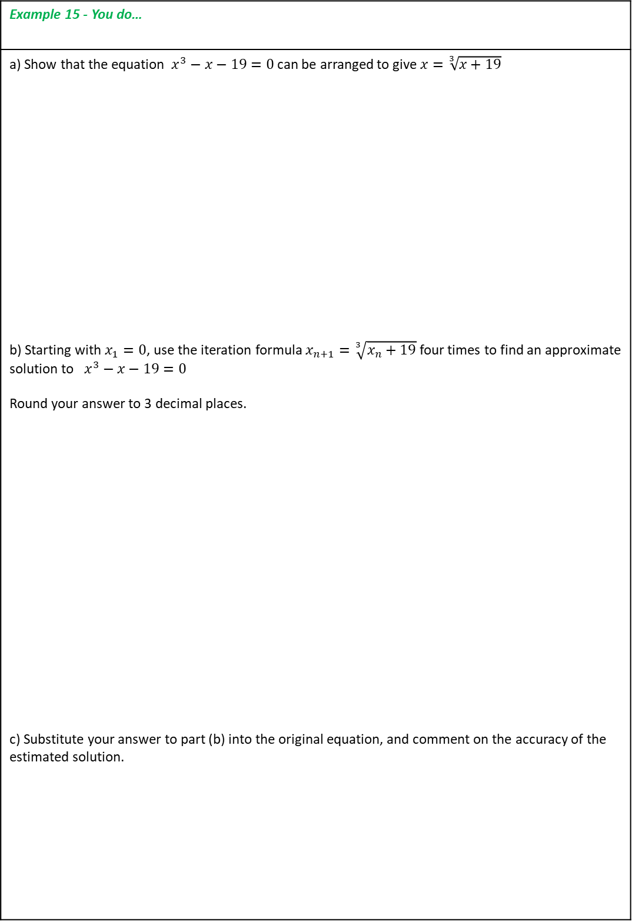
Example 15 - You do…
a) Show that the equation $x^{3}−x−19=0$ can be arranged to give $x=\sqrt[3]{x+19}$ b) Starting with $x_{1}=0$, use the iteration formula $x_{n+1}=\sqrt[3]{x_{n}+19}$ four times to find an approximate solution to $x^{3}−x−19=0$ Round your answer to 3 decimal places. c) Substitute your answer to part (b) into the original equation, and comment on the accuracy of the estimated solution.

Slide 13
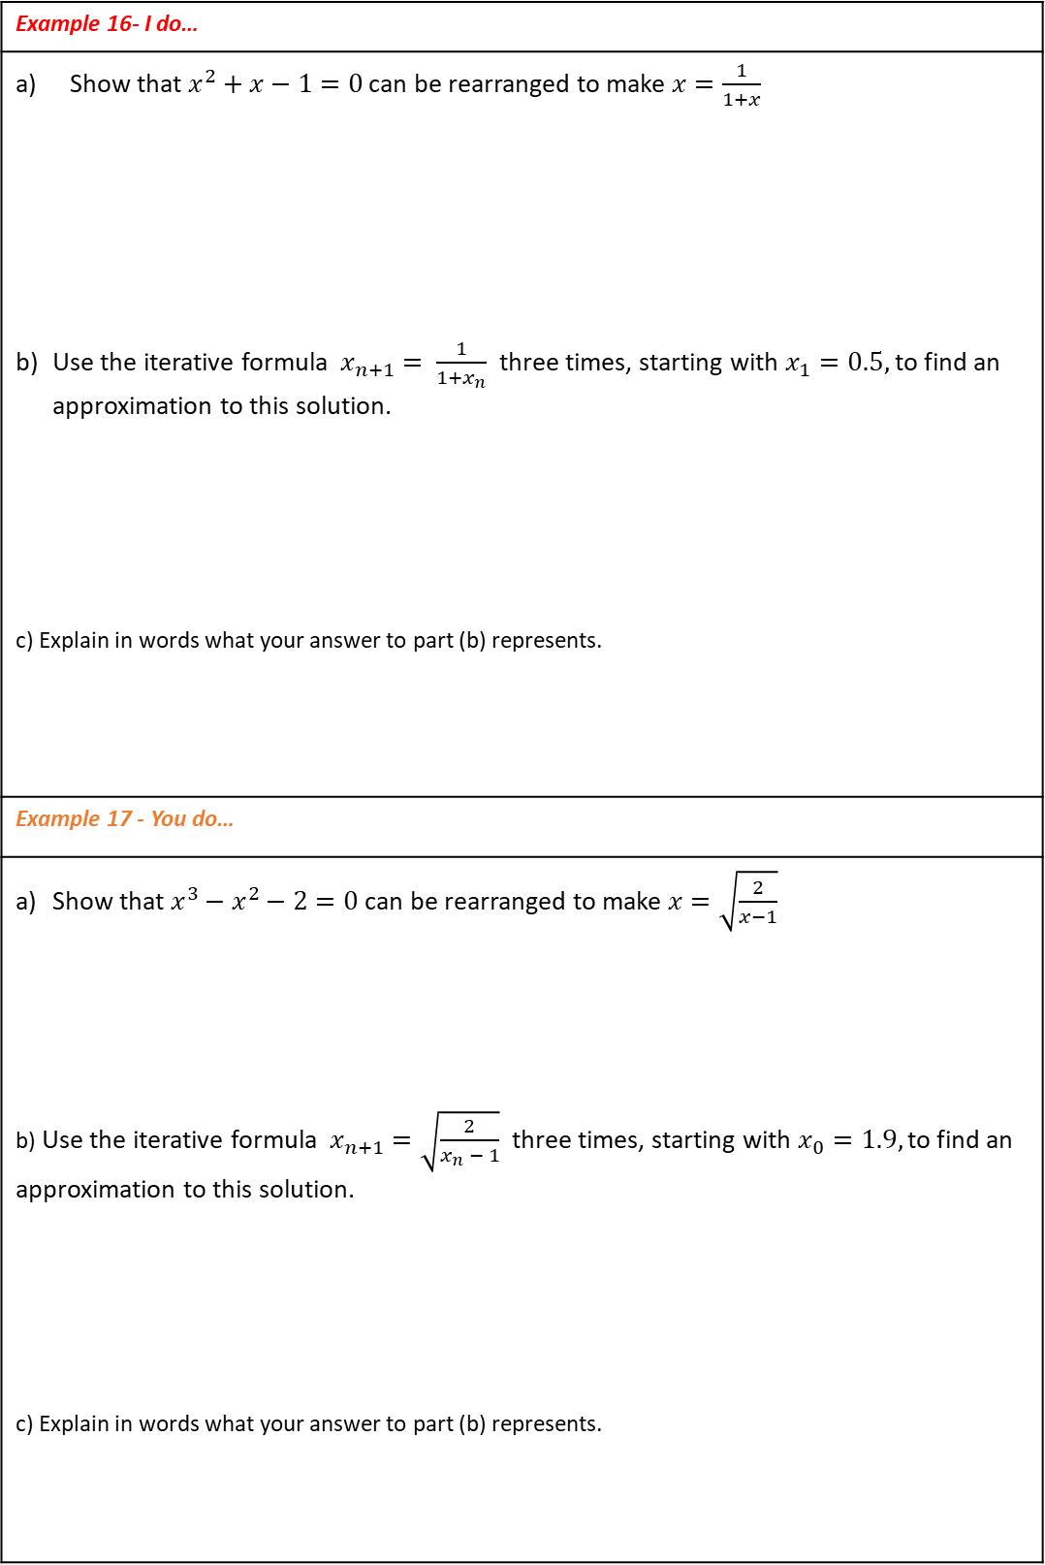
Example 16- I do…
Show that $x^{2}+x−1=0$ can be rearranged to make $x=\frac{1}{1+x}$ Use the iterative formula $x_{n+1}= \frac{1}{{1+x}_{n}}$ three times, starting with $x_{1}=0.5,$to find an approximation to this solution. c) Explain in words what your answer to part (b) represents.
Example 17 - You do…
Show that $x^{3}−x^{2}−2=0$ can be rearranged to make $x=\sqrt{\frac{2}{x−1}}$ b) Use the iterative formula $x_{n+1}=\sqrt{\frac{2}{x_{n} − 1}}$ three times, starting with $x_{0}=1.9,$to find an approximation to this solution. c) Explain in words what your answer to part (b) represents.

Slide 14
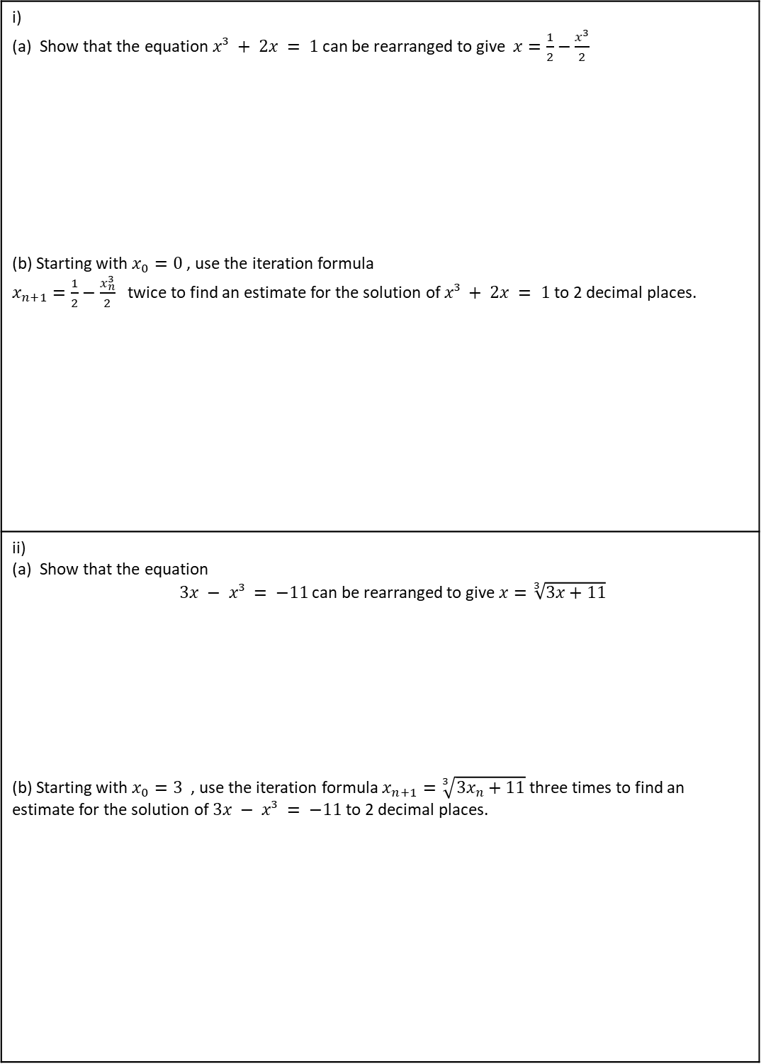
INDEPENDENT PRACTICE
4) Use iteration to find the roots in each equation.
i) (a) Show that the equation $x³ + 2x = 1$can be rearranged to give $x=\frac{1}{2}−\frac{x^{3}}{2}$ (b) Starting with $x_{0}=0$ , use the iteration formula $x_{n+1}=\frac{1}{2}−\frac{x_{n}^{3}}{2}$ twice to find an estimate for the solution of $x³ + 2x = 1$ to 2 decimal places.
ii) (a) Show that the equation $3x − x³ = −11$can be rearranged to give $x=\sqrt[3]{3x+11}$ (b) Starting with $x_{0}=3$ , use the iteration formula $x_{n+1}=\sqrt[3]{3x_{n}+11}$ three times to find an estimate for the solution of $3x − x³ = −11$ to 2 decimal places.

Slide 15
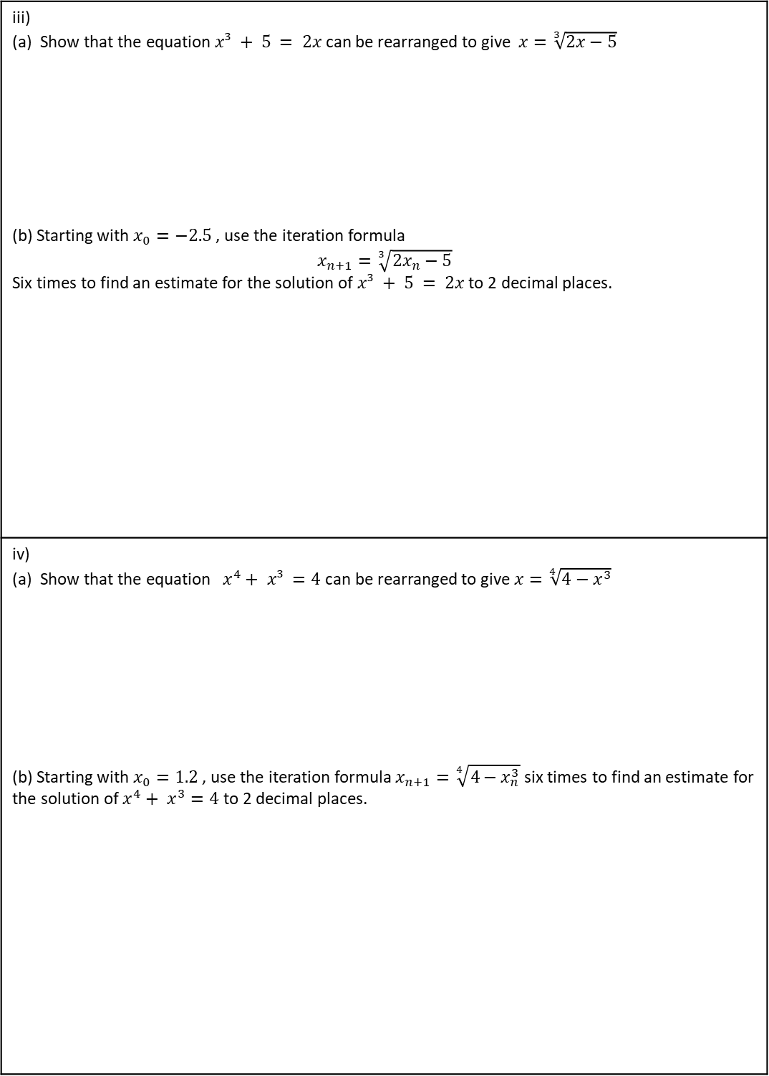
iii) (a) Show that the equation $x³ + 5 = 2x$can be rearranged to give $x=\sqrt[3]{2x−5}$ (b) Starting with $x_{0}=−2.5$ , use the iteration formula $$x_{n+1}=\sqrt[3]{2x_{n}−5}$$ Six times to find an estimate for the solution of $x³ + 5 = 2x$to 2 decimal places.
iv) (a) Show that the equation $x^{4}+ x³ =4$can be rearranged to give $x=\sqrt[4]{4−x^{3}}$ (b) Starting with $x_{0}=1.2$ , use the iteration formula $x_{n+1}=\sqrt[4]{4−x_{n}^{3}}$ six times to find an estimate for the solution of $x^{4}+ x^{3}=4$ to 2 decimal places.

Slide 16
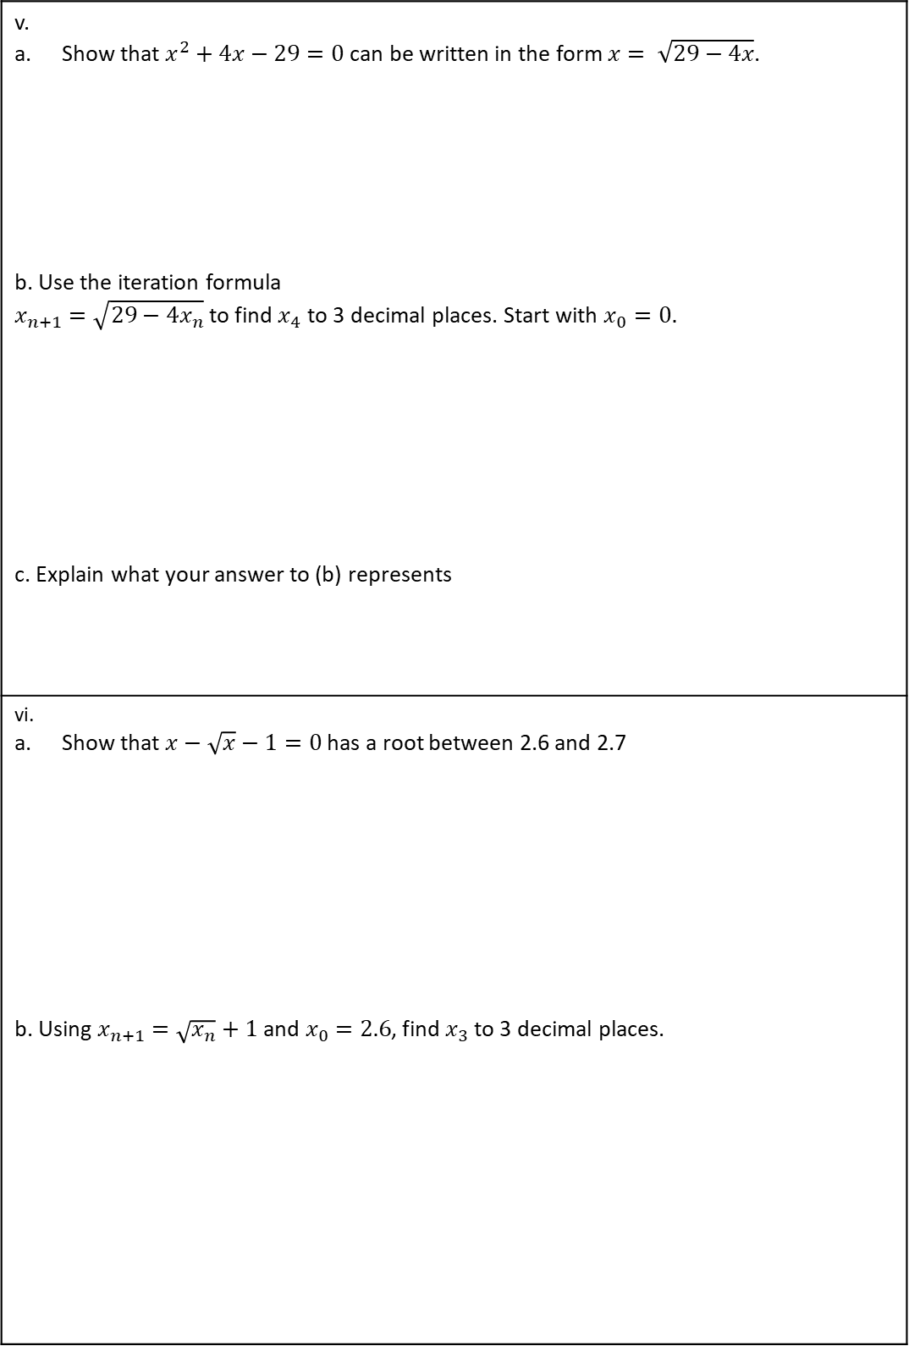
v. Show that $x^{2}+4x−29=0$ can be written in the form $x= \sqrt{29−4x}$. b. Use the iteration formula $x_{n+1}=\sqrt{29−4x_{n}}$ to find $x_{4}$ to 3 decimal places. Start with $x_{0}=0.$ c. Explain what your answer to (b) represents
vi. Show that $x−\sqrt{x}−1=0$ has a root between 2.6 and 2.7 b. Using $x_{n+1}=\sqrt{x_{n}}+1$ and $x_{0}=2.6$, find $x_{3}$ to 3 decimal places.

Slide 17
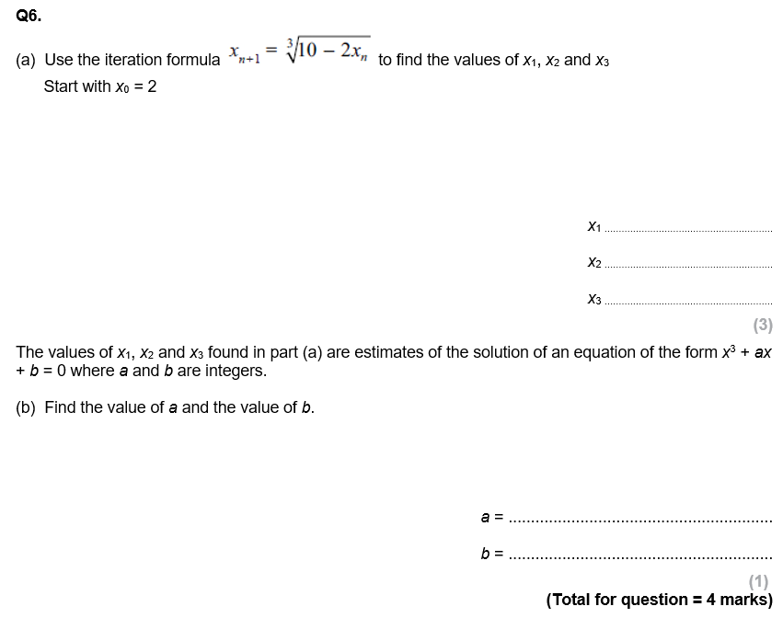
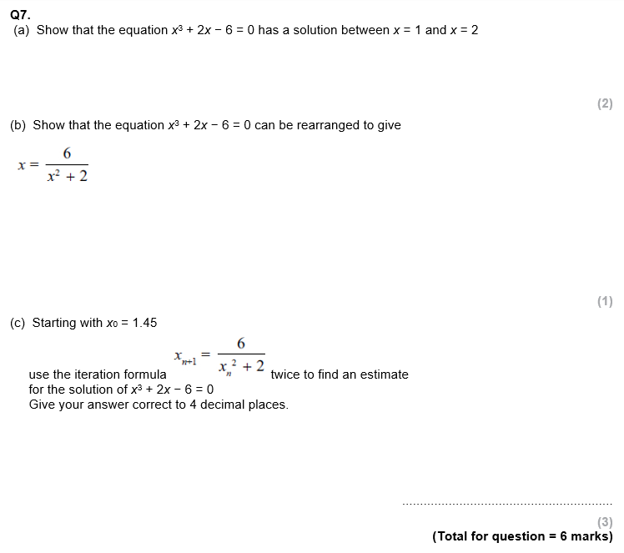
GCSE QUESTIONS

Slide 18
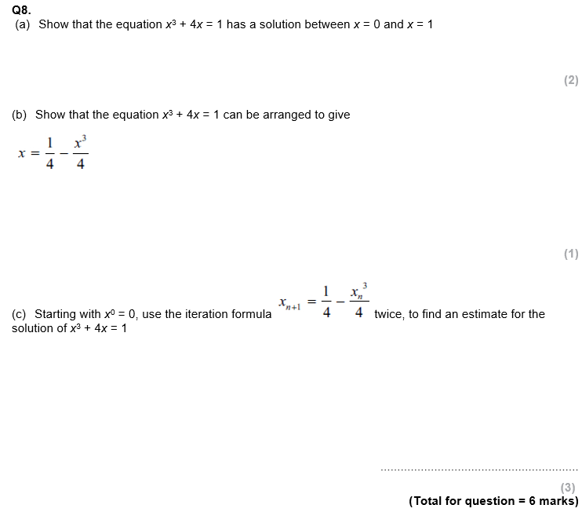
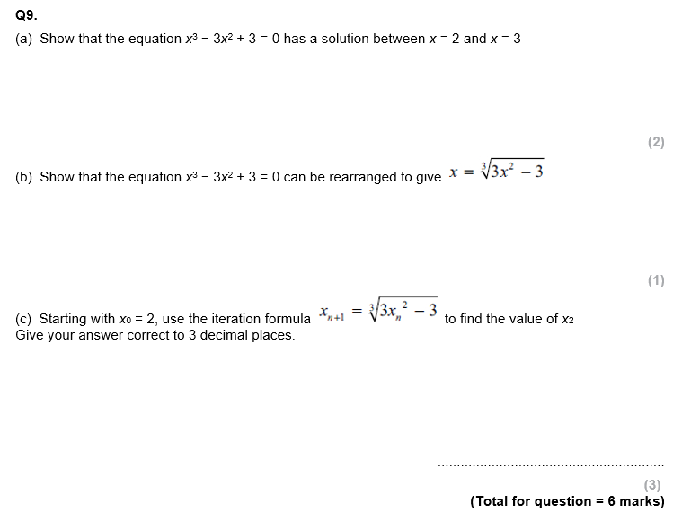

Slide 19
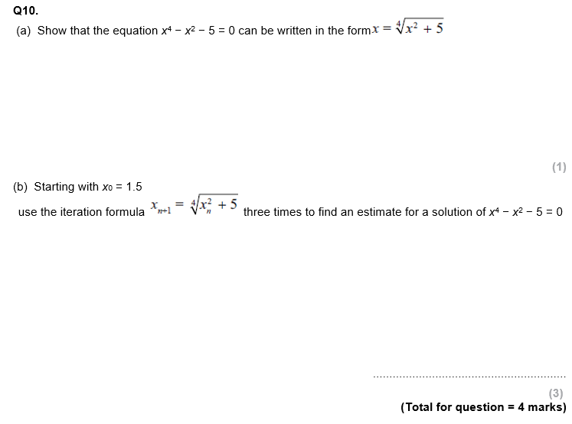
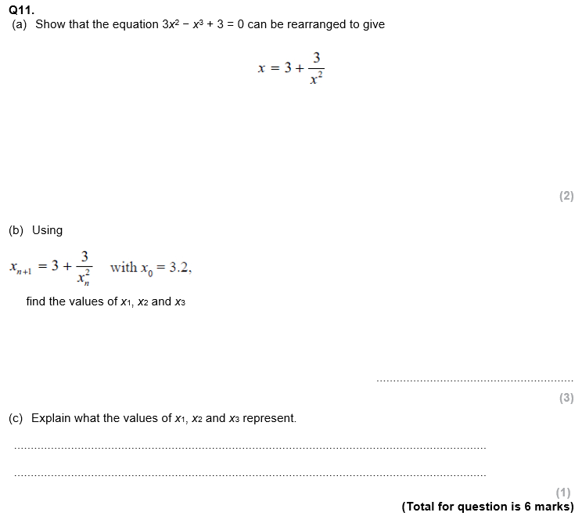

Slide 20
